Slide 1
Sentiment Analysis for Product Development and Marketing Strategy
By: Nivethitha P

Slide 2
Agenda
Problem Statement
Data Understanding
Data Cleaning and Pre-processing
Business Insights
Model Building

Slide 3
Problem Statement
The customer is a mobile manufacturer based in the US, which entered the market three years ago.
They want to understand their competitors and preferences of their users so that they can design their strategies accordingly.
They want to tweak the marketing strategies to add more value to their brand, provide features to customers that add the most value, and close the demand-supply gap.
Their objective is to increase the market share as well as the brand value.
Aim:
We have to provide them with some major insights into the mobile phone industry to help them achieve their objective. Their objective is to develop a new product optimally and create some marketing strategies.

Slide 4
Data Understanding
We have been provided with Amazon review data for different cell phones and accessories that were purchased between the years 1996 and2018.
Phone Data: This dataset provides the main customer activity on a product listing in Amazon. It gives us important details like overall rating, style, review, review sentiment of the product. This data set is hugely used for model building
Phone Metadata: This dataset provides as metadata about the products in the “Phone Data”. It provides us other information like features, brand, price and category the product belongs to. This data will be mainly used for deriving business insights for the customer
pos-words, neg_words, stop_words_long: These are .txt files provided to help us in improving the accuracy of the model and analysis

Slide 5
Data Cleansing and Pre - processing
Data cleaning:
We made sure the datasets used in the analysis are devoid of null values, duplicates and redundant data by removing columns with missing values > 35% and dropping unnecessary columns
2. Data filtering:
We filtered for products only with Category = “Cell Phones” so that we consider only the appropriate data for our analysis and exclude other unnecessary products of mobile accessories

Slide 6
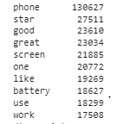
3. Data merging:
We merged the two datasets provided with ‘ASIN’ as the common column. The cleaned, merged dataset contains 62,642 rows and 11 columns for final model building and analysis
4. Data pre-processing:
We combined the ‘reviewText’ column and ‘Summary’ column as both the columns contain review data about the product.
We pre-processed the data and found the Top 10 words used in clean review text:

Slide 7
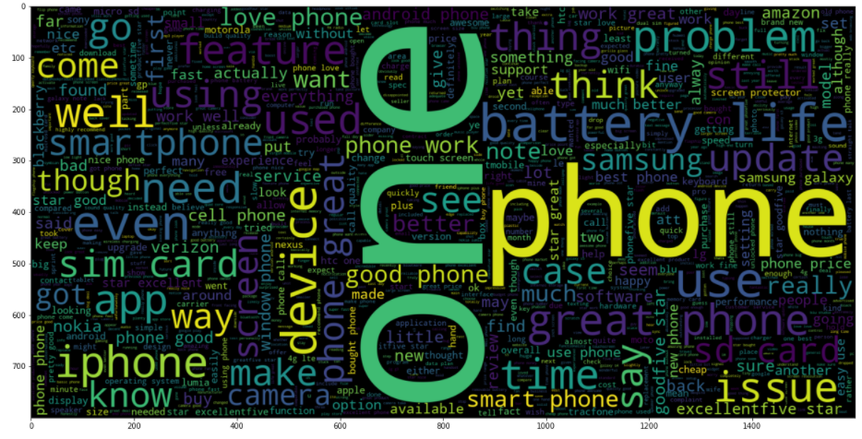
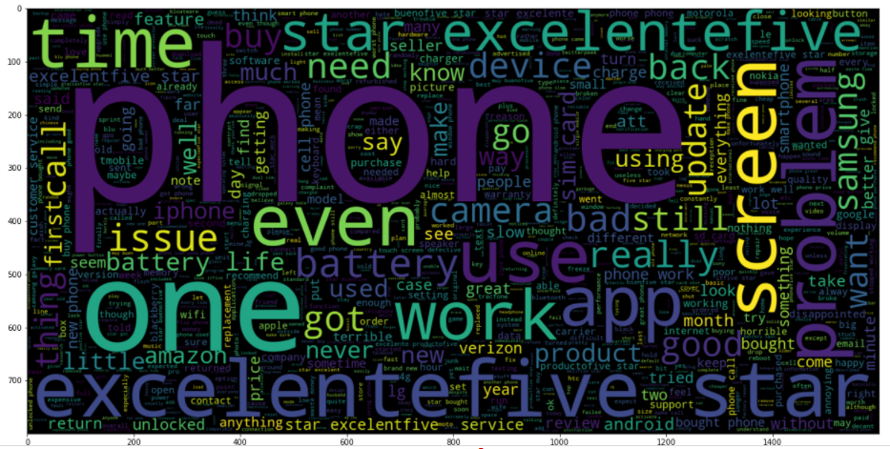
We have also plotted the word clouds for review texts with Positive and negative sentiment
Positive sentiment
Negative sentiment

Slide 8
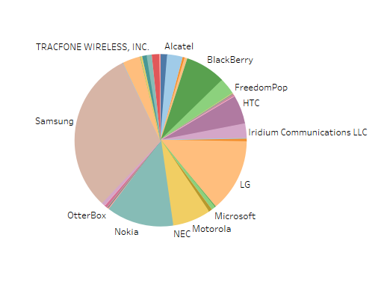
Business Insights
We have derived few business insights based on which the customer can build their product development and marketing strategy
Assuming that the number of reviews indicates the popularity of a brand, we have derived the top 10 popular brands in our analysis.
We understand that ‘Samsung is the most popular cell phone brand in the US, followed by LG, Nokia, Blackberry’

Slide 9
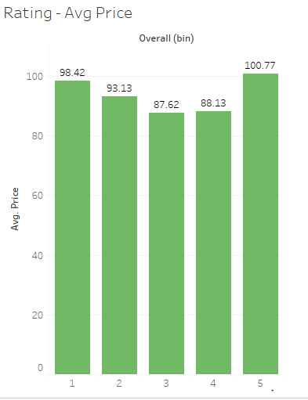
2. Cell phones that have an overall average rating of 5 are found in the higher end of the price range. We have considered only phones that at least have a minimum of 100 reviews for this analysis

Slide 10
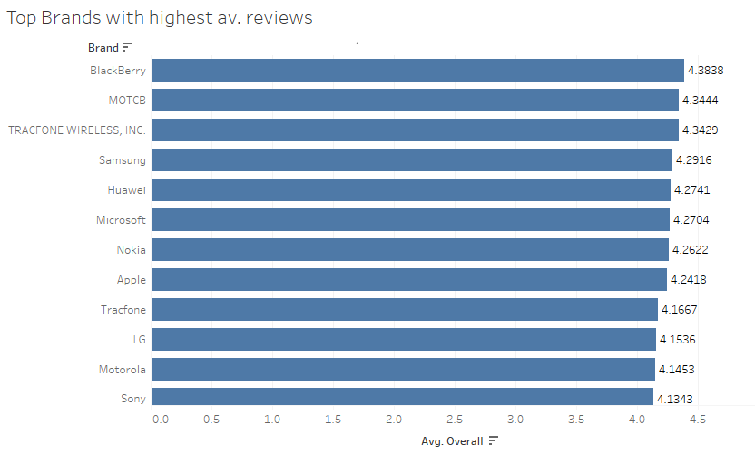
3. Top Brands with highest average reviews are “BlackBerry”, “MOTCB” and “Tracfone Wireless, INC.”. We have considered only phones that at least have a minimum of 100 reviews for this analysis

Slide 11
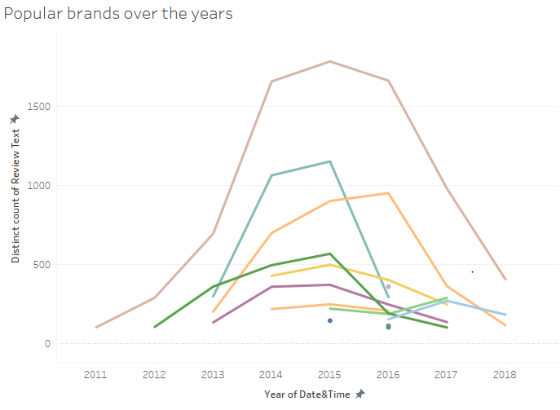
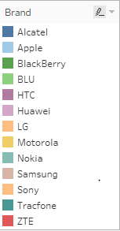
4. We have also shown the popular brand’s review activities over the years. 2015 and 2016 have received the most number of reviews

Slide 12
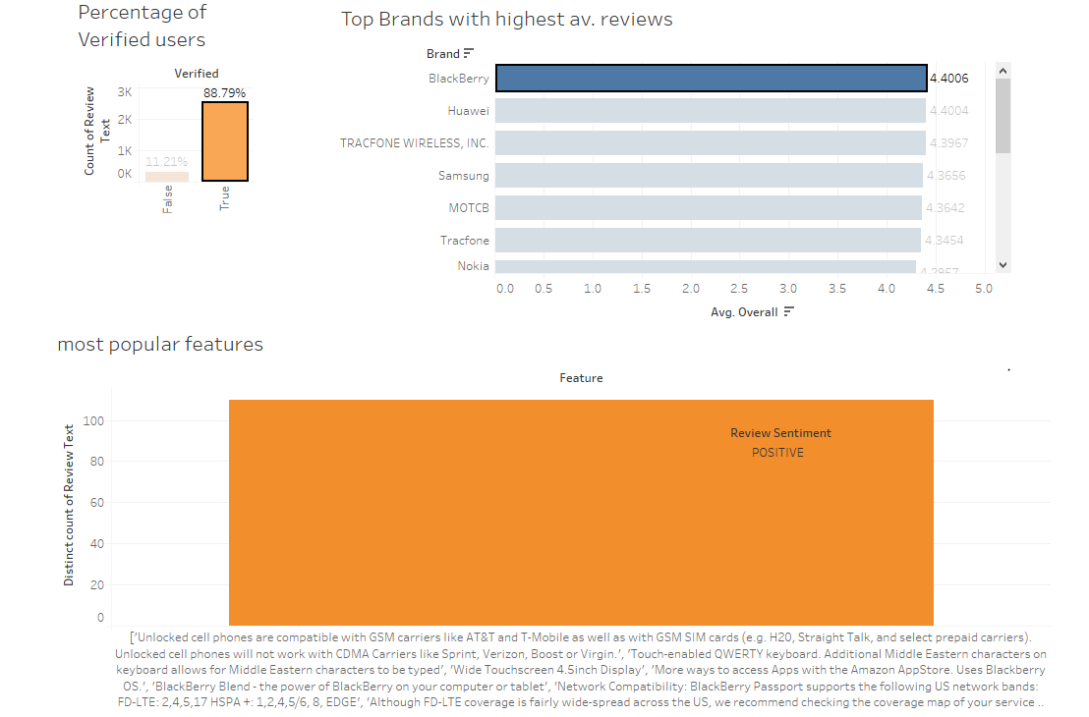
4. We then created a tableau dashboard to talk about the most talked about and popular features of the Top Brands with Highest average reviews. We also filtered it only for verified users
This visual shows the ‘Most popular’ features of Blackberry with positive review sentiment. Some of them are:
F1: Unlocked cell phones are compatible with GSM carriers like AT&T and T-Mobile as well as with GSM SIM cards.
F2: 'Touch-enabled QWERTY keyboard. Additional Middle Eastern characters on keyboard allows for Middle Eastern characters to be typed’,
F3:'Wide Touchscreen 4.5inch Display',

Slide 13
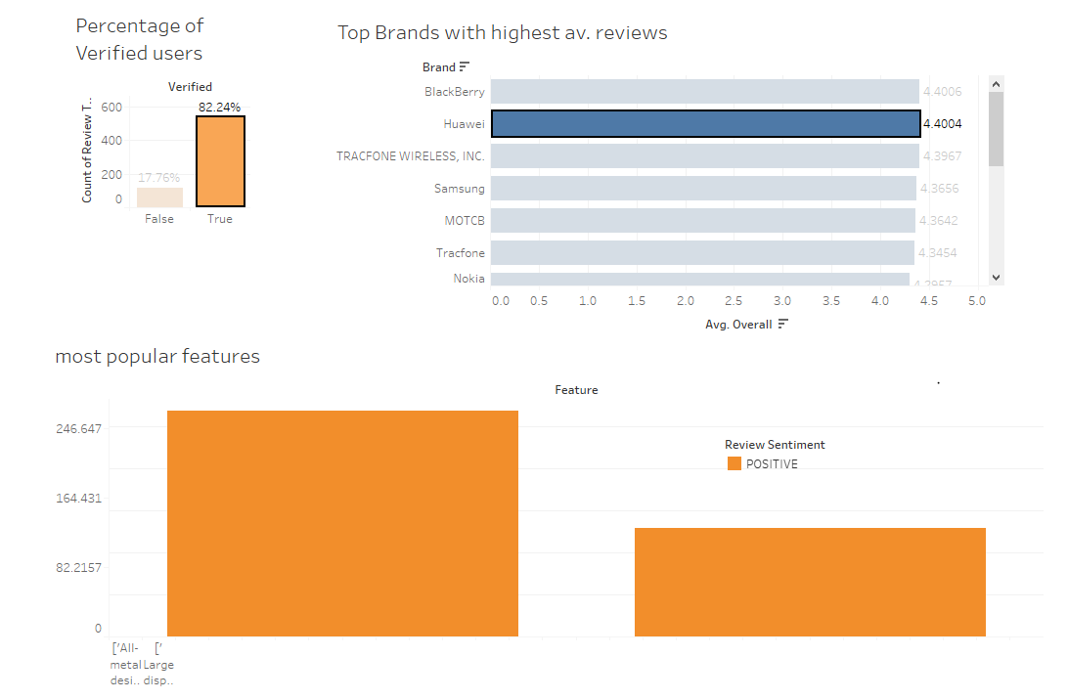
5. We followed the same steps for finding the ‘Most popular features’ of the next top rated brand - Huawei
F1: All-metal design Unlocked, LTE smartphone with a powerful 2GHz Snapdragon 810 V2.1 Processor and the newest Android software,
F2: Android 6.0 marshmallow.', 'A 5.7-Inch, high-resolution wqhd AMOLED display and front-facing stereo speakers to experience your photos and videos in cinematic Quality.’
F3: 'The powerful 12 MP Camera was built to capture your world in true-to-life detail.

Slide 14
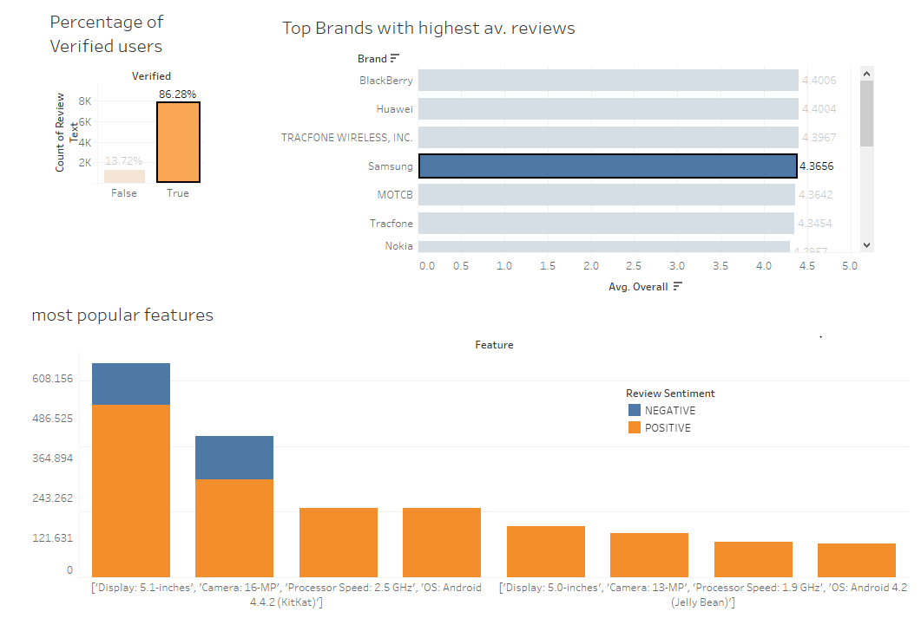
5. We followed the same steps for finding the ‘Most popular features’ of the brand with highest market share- Samsung
F1: 'Display: 5.1-inches', 'Camera: 16-MP’
F2: Processor Speed: 2.5 GHz', 'OS: Android 4.4.2 (KitKat)’
F3: Super AMOLED capacitive touchscreen 4.0-Inch

Slide 15
Model building
Step 1: We have used the lemmatization as a pre-processing step to improve the model performance
Step 2: We then move on to vectorized the dataset. For this we have selected a sample dataset of first 200 rows to improve model performance, without oversampling
Step 3: We then converted the cleaned text into numeric format (tf-idf) to feed into the machine learning model
Step 4: We then created training and test datasets in the ratio of 70:30

